Slide 1
Security in Computing, 4th Ed, Pfleeger
Chapter 7
Security in Networks
Part 2: Network Security Control
Notes:
The University of Adelaide, School of Computer Science
Chapter 2 — Instructions: Language of the Computer

Slide 2
Network Security Controls
Previous chapters have presented several strategies for addressing security concerns,
  such as encryption for confidentiality and integrity, reference monitors for access control, and overlapping controls for defense in depth
  These strategies are also useful in protecting networks.
Subsequent sections provide detailed explanations for three particularly important controls
  firewalls, intrusion detection systems, and encrypted e-mail.

Slide 3
Security Threat Analysis
Recall the three steps of a security threat analysis in other situations
  First, we scrutinize all the parts of a system so that we know what each part does and how it interacts with other parts
  Next, we consider possible damage to confidentiality, integrity, and availability
  Finally, we hypothesize the kinds of attacks that could cause this damage

Slide 4
Security Threat Analysis
We can take the same steps with a network
  We begin by looking at the individual parts of a network:
    local nodes connected via
    local communications links to a
    local area network, which also has
    local data storage, local processes, and local devices.
  The local network is also connected to a
    network gateway which gives access via
    network communications links to
    network control resources,
    network routers, and
    network resources, such as databases.

Slide 5
Security Threat Analysis
We can take the same steps with a network
  We posit a malicious agent (call him Hector) who wants to attack networked communications between two users, Andy and Bo. What might Hector do?
    Read communications from Andy to Bo
    Modify communications from Andy to Bo
    Forge communications allegedly from Andy to Bo
    Inhibit communications from Andy to Bo
    Inhibit all communications passing through a point.
    Read data at some machine C between Andy and Bo
    Modify or destroy data at C.

Slide 6
Security Threat Analysis
We summarize these threats with a list:
  intercepting data in traffic
  accessing programs or data at remote hosts
  modifying programs or data at remote hosts
  modifying data in transit
  inserting communications
  impersonating a user
  inserting a repeat of a previous communication
  blocking selected traffic
  blocking all traffic
  running a program at a remote host

Slide 7
Design and Implementation
Architecture
  The architecture or design of a network can have a significant effect on its security.
  Segmentation
    it can limit the potential for harm in a network in two important ways:
      Segmentation reduces the number of threats,
      and it limits the amount of damage a single vulnerability can allow.

Slide 8
Design and Implementation
Architecture
  Segmentation
    Assume your network implements electronic commerce for users of the Internet. The fundamental parts of your network may be
      a web server, to handle users' HTTP sessions
      application code, to present your goods and services for purchase
      a database of goods, and perhaps an accompanying inventory to the count of stock on hand and being requested from suppliers
      a database of orders taken
    If all these activities were to run on one machine, your network would be in trouble:
      Any compromise or failure of that machine would destroy your entire commerce capability.

Slide 9
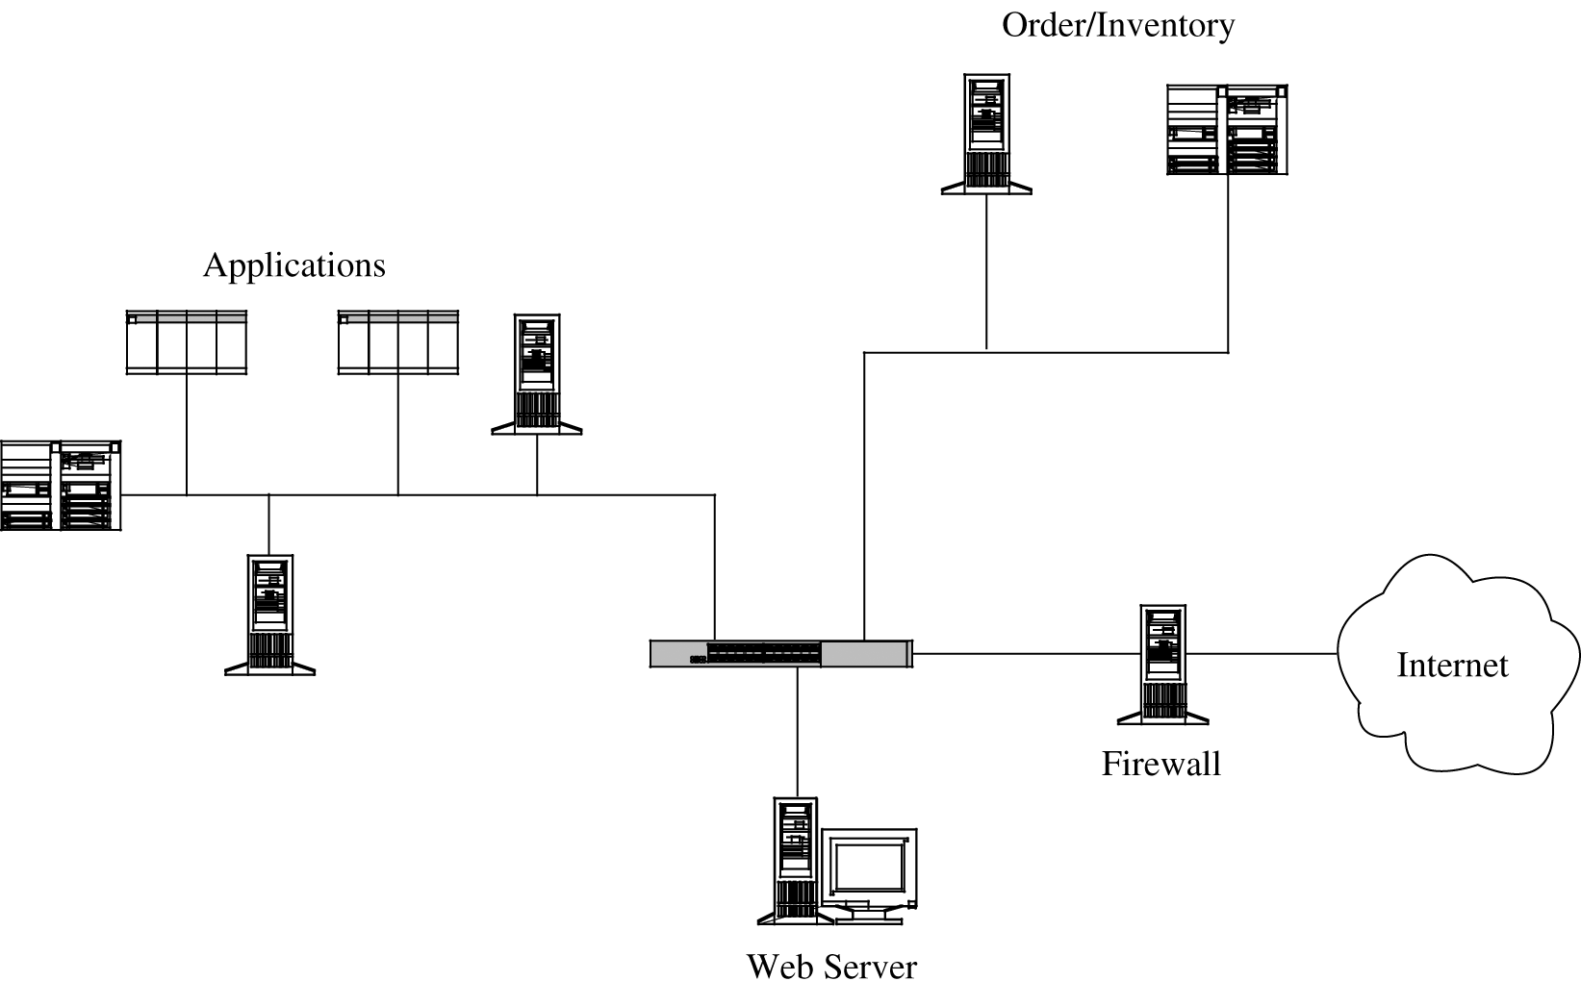
Design and Implementation
Architecture
  Segmentation
    A more secure design uses multiple segments
Figure 7-19 Segmented Architecture.

Slide 10
Design and Implementation
Architecture
  Segmentation
    Separate access is another way to segment the network.
    For example,
      suppose a network is being used for three purposes: using the "live" production system, testing the next production version, and developing subsequent systems.
      If the network is well segmented, external users should be able to access only the live system, testers should access only the test system, and developers should access only the development system.
      Segmentation permits these three populations to coexist without risking that, for instance, a developer will inadvertently change the production system.

Slide 11
Design and Implementation
Architecture
  Redundancy
    Another key architectural control is redundancy
    allowing a function to be performed on more than one node, to avoid "putting all the eggs in one basket."
    For example, the design of Figure 7-19 has only one web server; lose it and all connectivity is lost.
      A better design would have two servers, using what is called failover mode.
      In failover mode the servers communicate with each other periodically, each determining if the other is still active. If one fails, the other takes over processing for both of them.

Slide 12
Design and Implementation
Architecture
  Single Points of Failure
    the architecture should at least make sure that the system tolerates failure in an acceptable way
    we should ask if there is a single point in the network that, if it were to fail, could deny access to all or a significant part of the network
    for example, a single database in one location is vulnerable to all the failures that could affect that location.
    Good network design eliminates single points of failure.
    Distributing the database---placing copies of it on different network segments, perhaps even in different physical locations---can reduce the risk of serious harm from a failure at any one point.

Slide 13
Design and Implementation
Architecture
  Mobile Agents
    Mobile code and hostile agents are potential methods of attack, as described earlier in this chapter.
    Good agents might look for unsecured wireless access, software vulnerabilities, or embedded malicious code.

Slide 14
Encryption
Encryption is probably the most important and versatile tool for a network security expert.
  We have seen in earlier chapters that encryption is powerful for providing privacy, authenticity, integrity, and limited access to data.
  However, let us consider these points
    First, a flawed system design with encryption is still a flawed system design.
    Second, notice that encryption protects only what is encrypted
      Data are exposed before encryption and after decryption
    Finally, encryption is no more secure than its key management
      If an attacker can guess or deduce a weak encryption key, the game is over.
  In network applications, encryption can be applied either between
    two hosts (called link encryption)
    two applications (called end-to-end encryption)

Slide 15
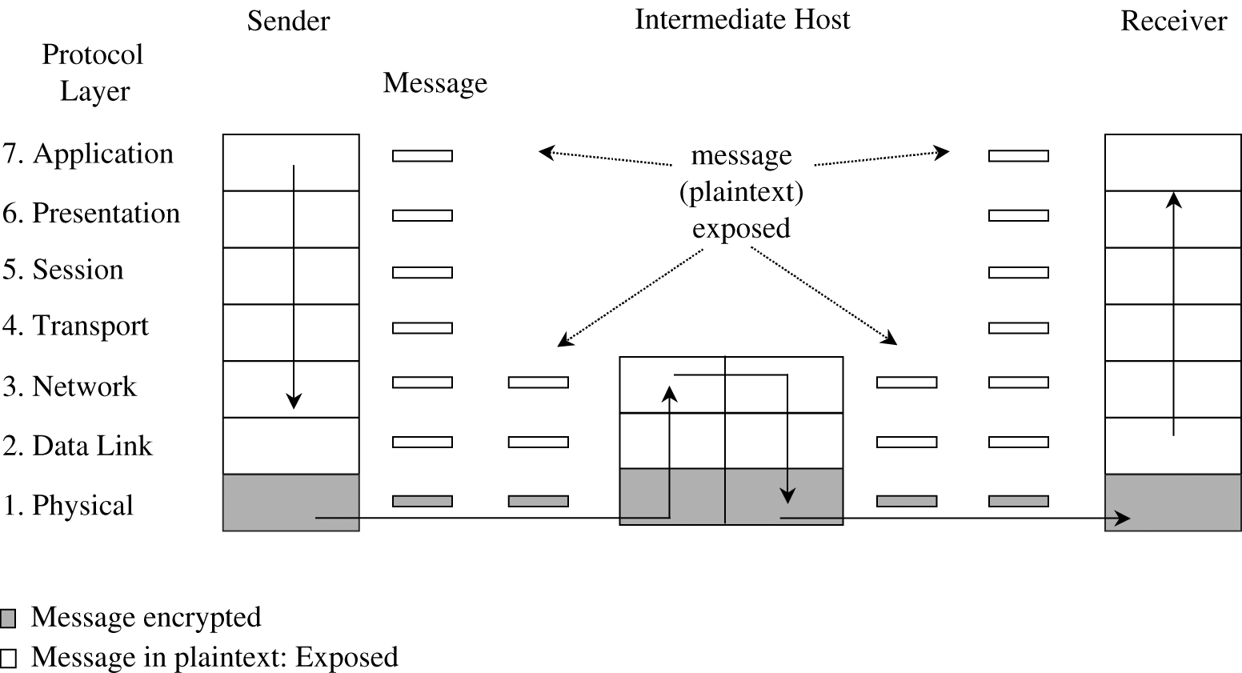
Link Encryption
In link encryption, data are encrypted just before the system places them on the physical communications link.
  at layer 1 or 2 in the OSI model.
  Similarly, decryption occurs just as the communication arrives at and enters the receiving computer
Figure 7-20 Link Encryption.

Slide 16
Link Encryption
Encryption protects the message in transit between two computers, but the message is in plaintext (in the clear) inside the hosts.
  Notice that because the encryption is added at the bottom protocol layer, the message is exposed in all other layers of the sender and receiver.
  Link encryption is invisible to the user.
    The encryption becomes a transmission service performed by a low-level network protocol layer
    just like message routing or transmission error detection
  Hardware encryption devices operate quickly and reliably;
    in this case, link encryption is invisible to the operating system as well as to the operator
  Link encryption is especially appropriate when the transmission line is the point of greatest vulnerability

Slide 17
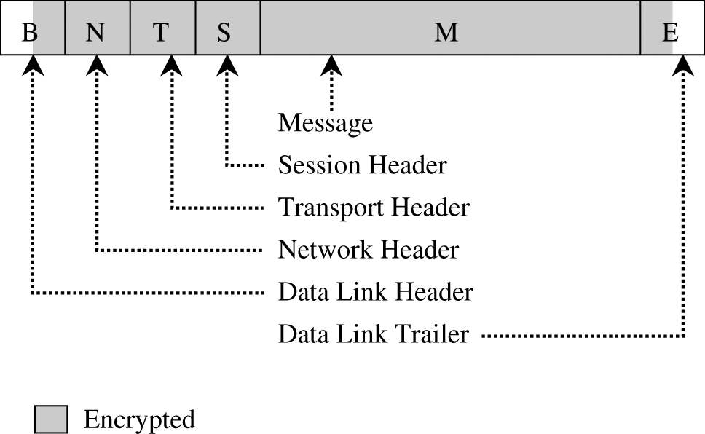
Link Encryption
Figure 7-21 Message Under Link Encryption.

Slide 18
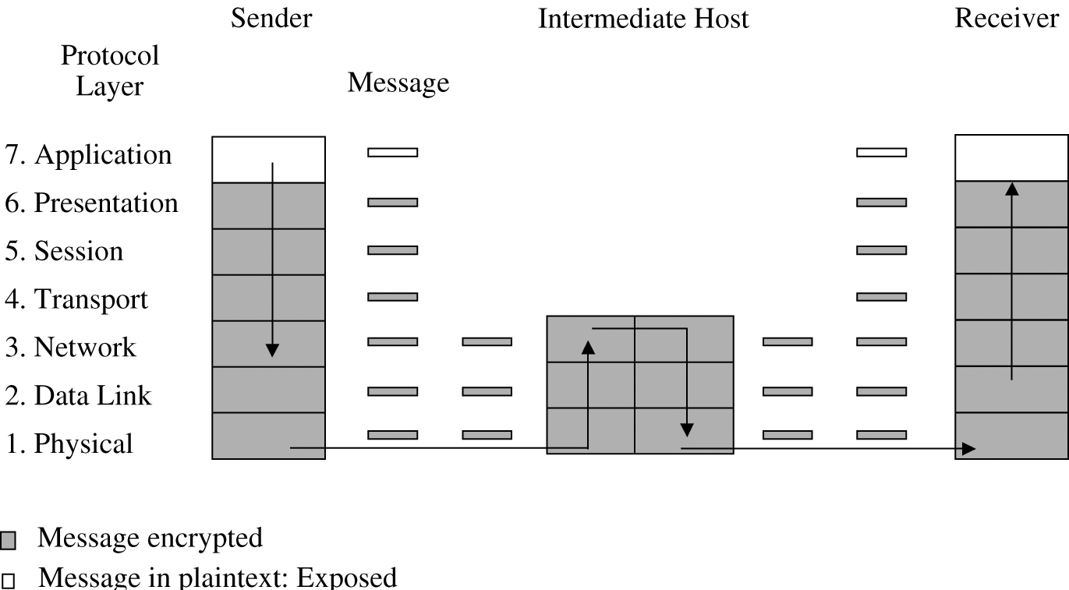
End-to-End Encryption
provides security from one end of a transmission to the other
  Can be done by hardware or software
  performed at the highest network levels (layer 7, application, or perhaps at layer 6, presentation) of the OSI model
Figure 7-22 End-to-End Encryption.

Slide 19
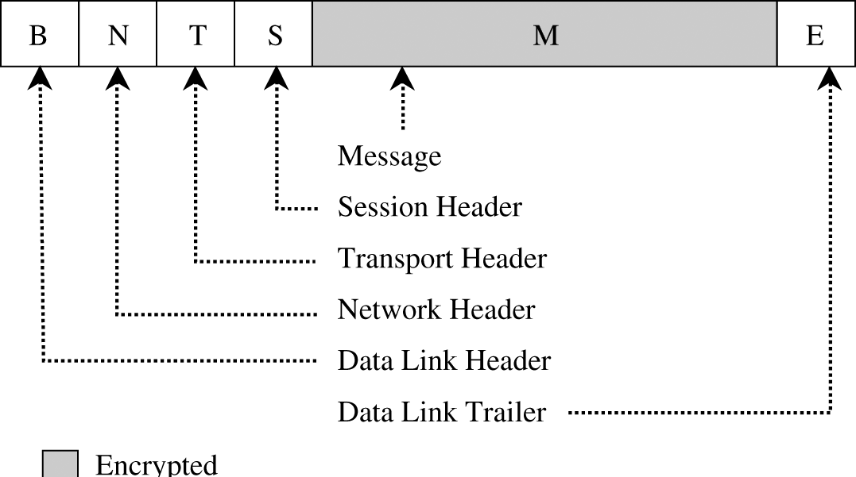
End-to-End Encryption
Figure 7-23 End-to-End Encrypted Message.

Slide 20
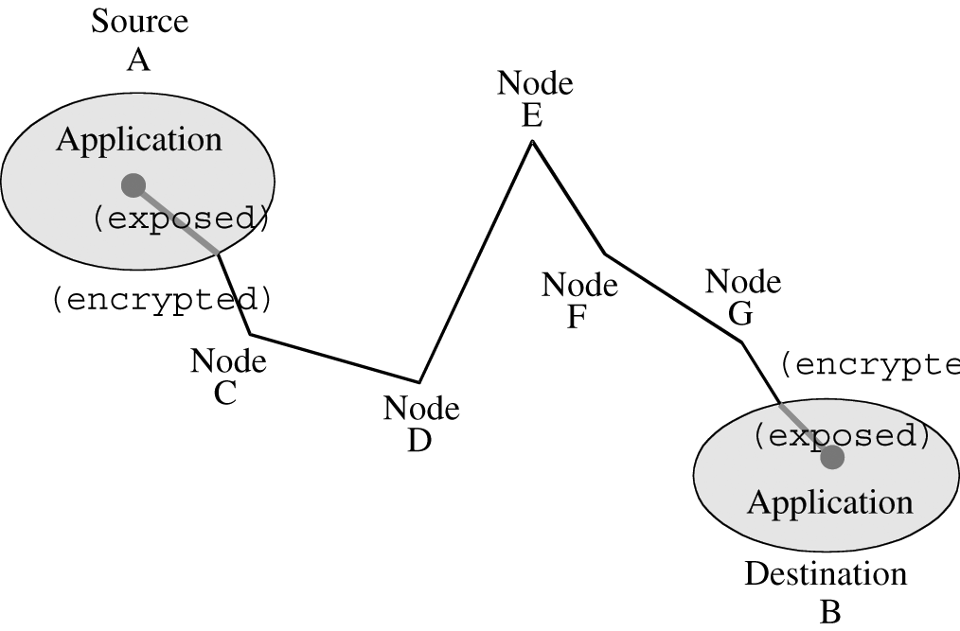
End-to-End Encryption
Figure 7-24 Encrypted Message Passing Through a Host.

Slide 21
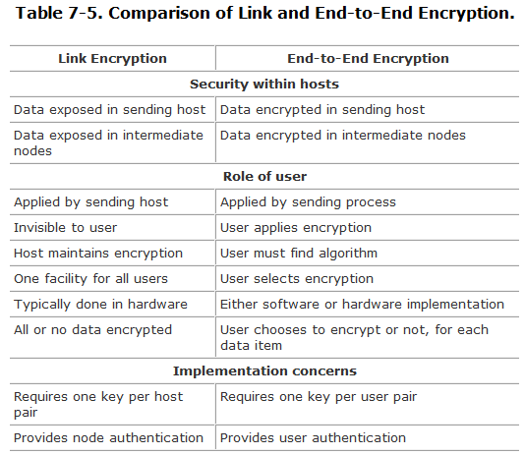
Comparison of Encryption Methods

Slide 22
Virtual Private Networks (VPN)
Link encryption can be used to give a network's users the sense that they are on a private network
  even when it is part of a public network
For this reason, the approach is called a virtual private network (or VPN).
Typically, physical security and administrative security are strong enough to protect transmission inside the perimeter of a network.
  the greatest exposure for a user is between the user's workstation or client and the perimeter of the host network or server.

Slide 23
Virtual Private Networks (VPN)
A firewall is an access control device that sits between two networks or two network segments.
  It filters all traffic between the protected or "inside" network and a less trustworthy or "outside" network or segment
Many firewalls can be used to implement a VPN.
  the user can request a VPN session with the firewall
  The user's client and the firewall negotiate a session encryption key
  the firewall and the client subsequently use that key to encrypt all traffic between the two
  it feels to the user that the network is private, even though it is not.
With the VPN, we say that the communication passes through an encrypted tunnel or tunnel.

Slide 24
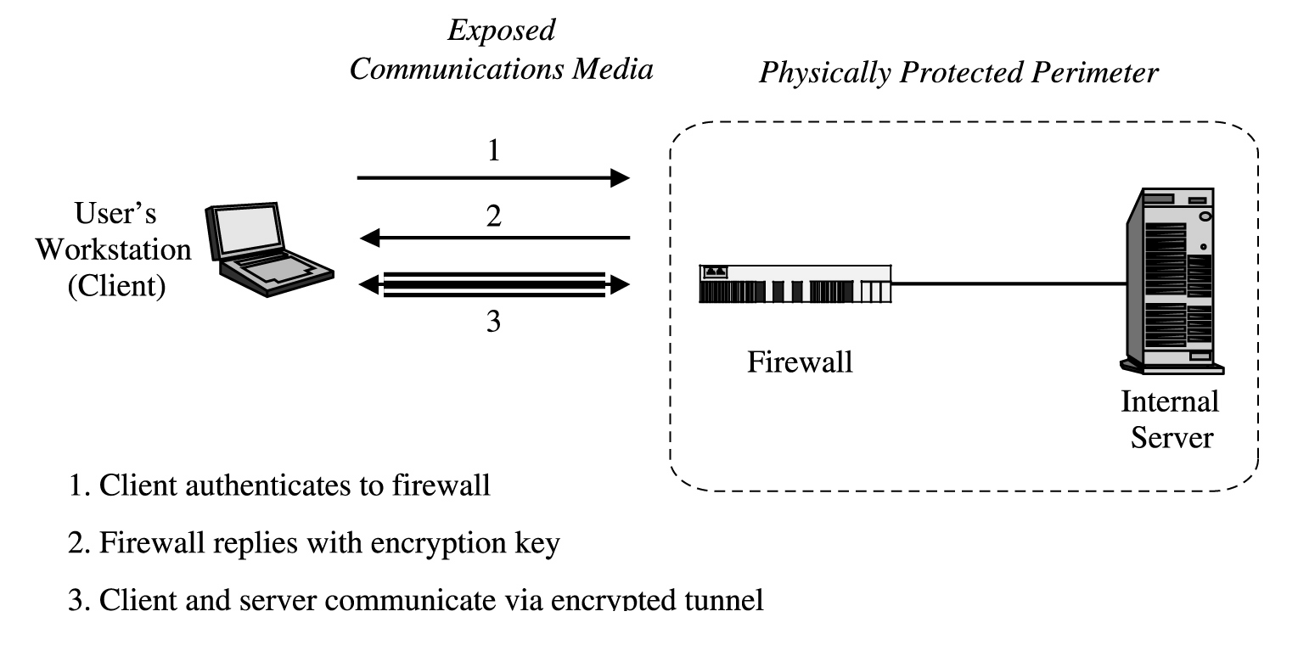
Virtual Private Networks (VPN)
Figure 7-25 Establishing a Virtual Private Network.

Slide 25
SSH Encryption (secure shell)
A pair of protocols (versions 1 and 2) that provides an authenticated and encrypted path to the shell or operating system command interpreter.
  Both SSH versions replace Unix utilities such as Telnet, rlogin, and rsh for remote access.
The SSH protocol involves negotiation between local and remote sites for encryption algorithm (for example, DES, IDEA, AES) and authentication (including public key and Kerberos).
  VPN vs. SSH: http://www.howtogeek.com/118145/vpn-vs.-ssh-tunnel-which-is-more-secure/

Slide 26
SSL Encryption(Secure Sockets Layer)
Originally designed by Netscape to protect communication between a web browser and server
  It is also known now as TLS, for transport layer security
  Most widely used secure communication protocol on the Internet
  SSL interfaces between applications (such as browsers) and the TCP/IP protocols to provide server authentication, optional client authentication, and an encrypted communications channel between client and server
  Client and server negotiate a mutually supported suite of encryption for session encryption and hashing
    possibilities include triple DES and SHA1, or RC4 with a 128-bit key and MD5.

Slide 27
SSL Encryption(Secure Sockets Layer)
To use SSL,
  the client requests an SSL session
  The server responds with its public key certificate so that the client can determine the authenticity of the server.
  The client returns part of a symmetric session key encrypted under the server's public key
  Both the server and client compute the session key
  then they switch to encrypted communication, using the shared session key

Slide 28
PKI and Certificates
A public key infrastructure, or PKI, is a process created to enable users to implement public key cryptography, usually in a large (and frequently, distributed) setting.
  PKI offers each user a set of services, related to identification and access control, as follows:
    Create certificates associating a user's identity with a (public) cryptographic key
    Give out certificates from its database
    Sign certificates, adding its credibility to the authenticity of the certificate
    Confirm (or deny) that a certificate is valid
    Invalidate certificates for users who no longer are allowed access or whose private key has been exposed

Slide 29
PKI and Certificates
PKI is often considered to be a standard, but in fact it is a set of policies, products, and procedures
  In particular, the policies specify how to handle keys and valuable information and how to match level of control to level of risk.
  The procedures dictate how the keys should be generated, managed, and used
  Finally, the products actually implement the policies, and they generate, store, and manage the keys.
PKI sets up entities, called certificate authorities, that implement the PKI policy on certificates.
  The general idea is that a certificate authority is trusted
    users can delegate the construction, issuance, acceptance, and revocation of certificates to the authority

Slide 30
PKI and Certificates
The specific actions of a certificate authority include the following:
  managing public key certificates for their whole life cycle
  issuing certificates by binding a user's or system's identity to a public key with a digital signature
  scheduling expiration dates for certificates
  ensuring that certificates are revoked when necessary by publishing certificate revocation lists
PKI also involves a registration authority that acts as an interface between a user and a certificate authority
  captures and authenticates the identity of a user and then submits a certificate request to the appropriate certificate authority.

Slide 31
IPSec
As a part of the IPv6 suite, the IETF adopted IPSec, or the IP Security Protocol Suite.
Designed to address fundamental shortcomings
  spoofing, eavesdropping, and session hijacking
  defines a standard means for handling encrypted data.
  IPSec requires no change to the existing large number of TCP and UDP protocols
Like SSL, it was designed to be independent of specific cryptographic protocols and to allow the two communicating parties to agree on a mutually supported set of protocols.

Slide 32
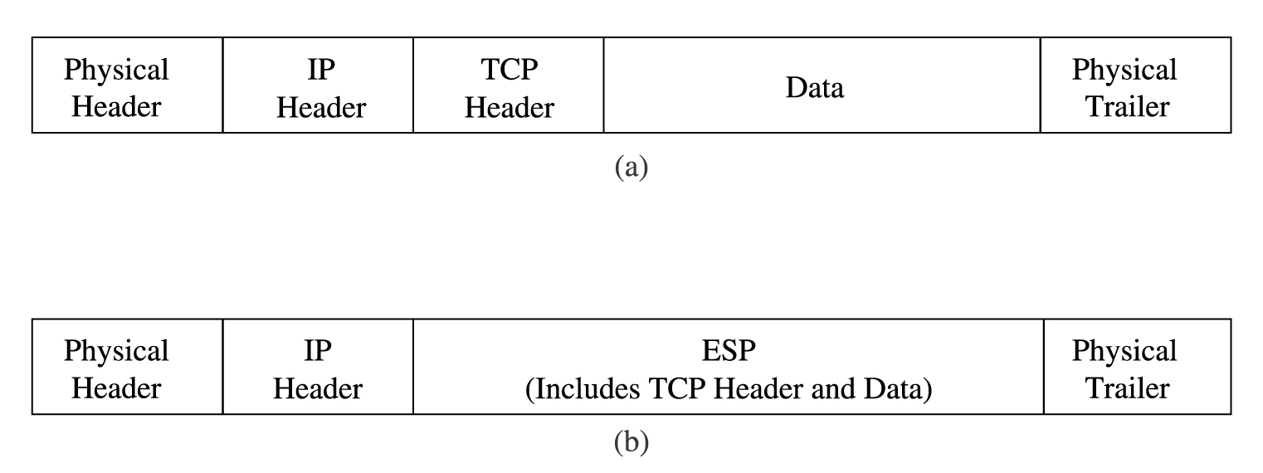
IPSec
Figure 7-27 Packets: (a) Conventional Packet;
(b) IPSec Packet.
ESP (encapsulated security payload).

Slide 33
Strong Authentication
One-Time Password
Challenge-Response Systems
Kerberos
  a system that supports authentication in distributed systems

Slide 34
Access Controls
Authentication deals with the who of security policy enforcement; access controls enforce the what and how.

Slide 35
Access Controls
ACLs on Routers
  Routers perform the major task of directing network traffic either to subnetworks they control or to other routers
  Routers convert external IP addresses into internal MAC addresses of hosts on a local subnetwork.
  Routers can be configured with access control lists to deny access to particular hosts from particular hosts
    for internal subnetworks, ACLs can be used effectively to restrict certain traffic flows
    But for large-scale, general traffic screening, routers are less useful than firewalls
      Because of the lack of performance

Slide 36
Access Controls
Firewalls
  A firewall does the screening that is less appropriate for a router to do
  A router's primary function is addressing, whereas a firewall's primary function is filtering
  Furthermore, firewalls can do auditing, examine entire packet’s contents
  We will study firewalls in an entire section later in this chapter.

Slide 37
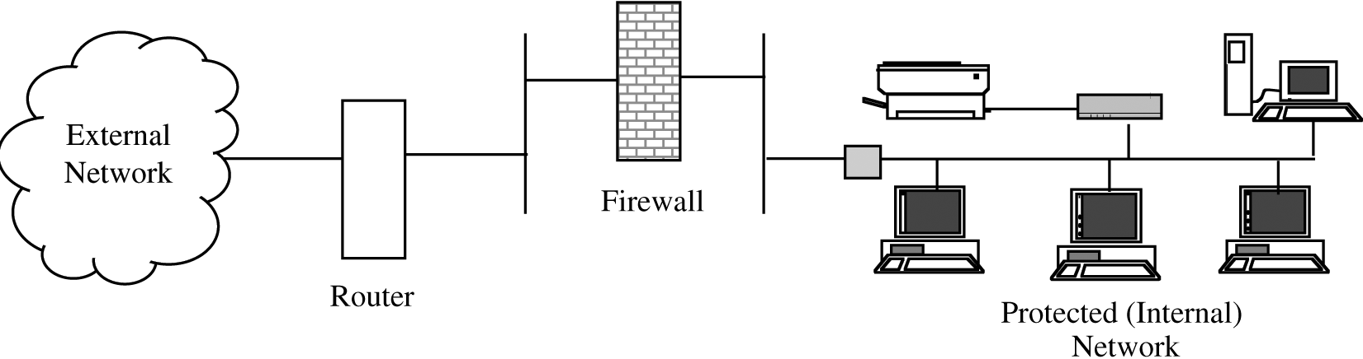
Alarms and Alerts
Figure 7-32 Layered Network Protection.
both a router and a firewall provide layers of protection for the internal network
Now let us add one more layer to this defense.
  An intrusion detection system is a device that is placed inside a protected network to monitor what occurs within the network
  offers the opportunity to detect the attack at the beginning, in progress, or after it has occurred.

Slide 38
Honeypots
Honeypot: a computer system open to attackers.
  Attracts attackers
You put up a honeypot for several reasons:
  to watch what attackers do, in order to learn about new attacks (so that you can strengthen your defenses against these new attacks)
  to lure an attacker to a place in which you may be able to learn enough to identify and stop the attacker
  to provide an attractive but diversionary playground, hoping that the attacker will leave your real system alone
A honeypot has no special features.
  just a computer system or a network segment, loaded with servers and devices and data

Slide 39
Traffic Flow Security
Earlier in this chapter, we listed threats, including a threat of traffic flow inference.
  If the attacker can detect an exceptional volume of traffic between two points, the attacker may infer the location of an event about to occur.
The countermeasure to traffic flow threats is to disguise the traffic flow
  ensure a steady volume of traffic between two points
    pad the traffic stream with many spurious packets
  A more sophisticated approach to traffic flow security is called onion routing
    A wants to send a message to B but doesn't want anyone in or intercepting traffic on the network to know A is communicating with B

Slide 40
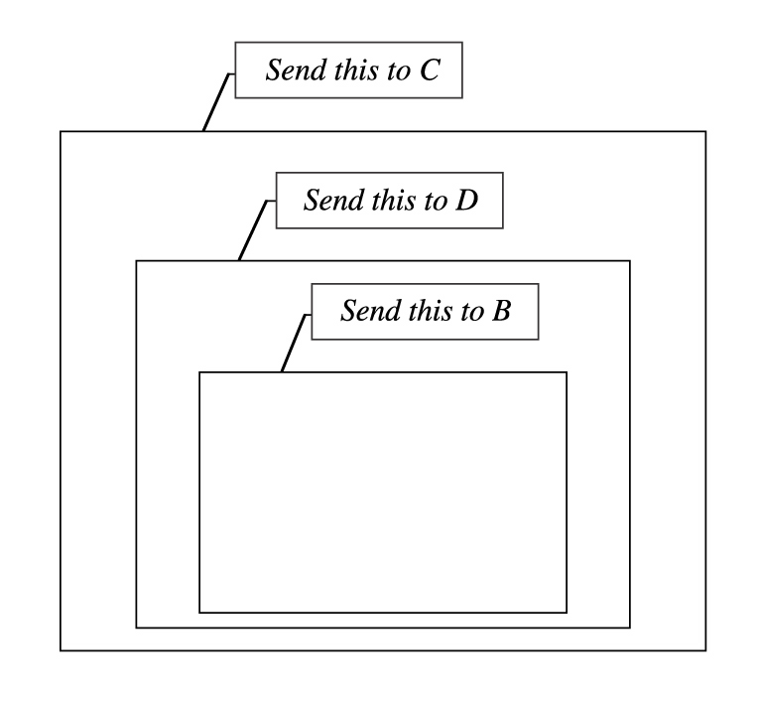
Traffic Flow Security
Figure 7-33 Onion Routing.
A takes the message to B, wraps it in a package for D to send to B. Then, A wraps that package in another package for C to send to D. Finally, A sends this package to C.

Slide 41
Wireless Security
Wireless communications are on predefined radio frequencies, you can expect an eavesdropping attacker to try to intercept and impersonate
Pieces to protect are
  finding the access point
  authenticating the remote computer to the access point, and vice versa
  and protecting the communication stream
SSID (Service Set Identifier)
  The identification of an access point
  it is a string of up to 32 characters
  Obviously the SSIDs need to be unique in a given area to distinguish one wireless network from another
  A client and an access point engage in a handshake to locate each other: probes and beacons

Slide 42
Wireless Security
WEP (Wired Equivalent Privacy)
  was meant to provide users privacy equivalent to that of a dedicated wire (immunity to most eavesdropping and impersonation attacks)
  WEP uses an encryption key shared between the client and the access point
  To authenticate a user
    the access point sends a random number to the client,
    the client encrypts the number using the shared key
    and returns to the access point.
    From that point on, the client and access point are authenticated and can communicate using their shared encryption key.

Slide 43
Wireless Security
WEP (wired equivalent privacy)
  Problems with WEP
    First, the WEP standard uses either a 64- or 128-bit encryption key
      The user enters the key in any convenient form, usually in hexadecimal or as an alphanumeric string that is converted to a number
      Not surprisingly, hex strings like C0DE C0DE… (that is a zero between C and D) are common.
      Thus, Passphrases are vulnerable to a dictionary attack.
    Even if the key is strong, it really has an effective length of only 40 or 104 bits because of the way it is used in the algorithm (RC4).
      Several tools, starting with WEPCrack and AirSnort, allow an attacker to crack a WEP encryption, usually in a few minutes
      At a 2005 conference, the FBI demonstrated the ease with which a WEP-secured wireless session can be broken.

Slide 44
Wireless Security
WPA and WPA2
  The alternative to WEP is WiFi Protected Access or WPA, approved in 2003.
How does WPA improve upon WEP?
  First, WEP uses an encryption key that is unchanged until the user enters a new key at the client and access point
    WPA has a key change approach, called Temporal Key Integrity Program (TKIP), by which the encryption key is changed automatically on each packet.
  Second, WEP uses the encryption key as an authenticator
    WPA employs the extensible authentication protocol (EAP) by which authentication can be done by password, token, certificate, or other mechanism.
    For small network (home) users, this probably still means a shared secret, which is not ideal.
      Users are prone to selecting weak keys, such as short numbers or pass phrases subject to a dictionary attack.

Slide 45
Wireless Security
  Third, the encryption algorithm for WEP is RC4
    which has cryptographic flaws both in key length and design
    In WEP the initialization vector for RC4 is only 24 bits, a size so small that collisions commonly occur
    there is no check against initialization vector reuse
    WPA2 adds AES as a possible encryption algorithm (although RC4 is also still supported for compatibility reasons)
  WEP includes a 32-bit integrity check separate from the data portion.
    because the WEP encryption is subject to cryptanalytic attack, the integrity check was also subject
    WPA includes a 64-bit integrity check that is encrypted.
  Setup for WPA involves three protocol steps: authentication, a four-way handshake (to ensure that the client can generate cryptographic keys and to generate and install keys for both encryption and integrity on both ends), and an optional group key handshake (for multicast communication.)

